Slide 1
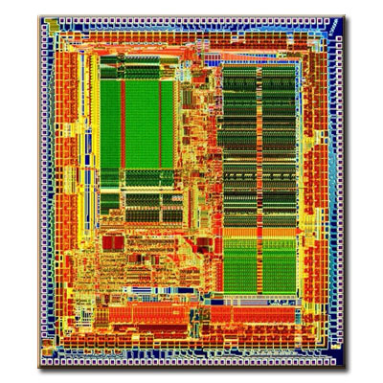
Processor Design
5Z032
SystemC + miniMIPS
Henk Corporaal
Eindhoven University of Technology
2011

Slide 2
SystemC and our MIPS project
As part of the lab you’ll be building a real MIPS processor
  Here we discuss the so-called mmMIPS (miniminiMIPS)
    based on your book, ch 5 and 6 (3rd ed) / ch 4 (4th ed)
  It has only 9 instructions, in 3 categories:
    arithmetic
    data load and store
    branch and jump
  Described in SystemC
In the lab (exercise B) we directly start with the mMIPS (miniMIPS)
  it has about 35 instructions
  it can run C-code by using the available LCC C-compiler
SystemC; we discuss
  basics (module example, tracing, main function)
  modules and submodules
  processes
  data types

Slide 3
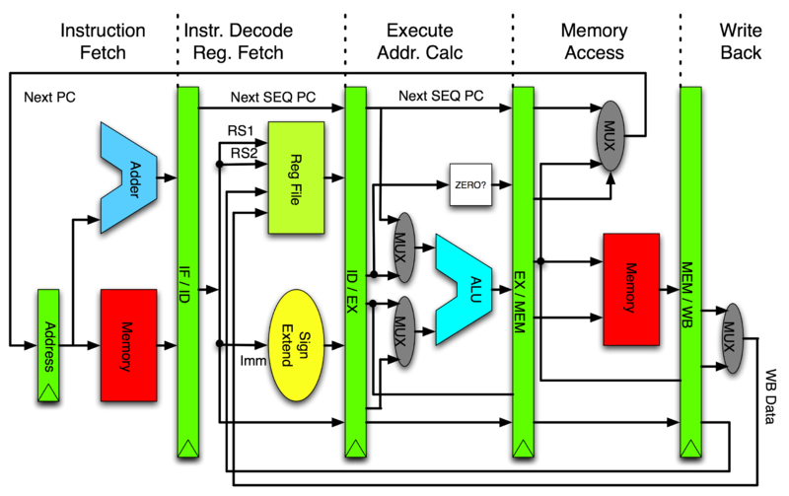
mmMIPS (pipelined version)

Slide 4

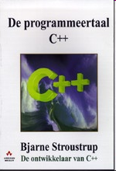
Hardware-software co-design
We’re designing a processor system.
  This is hardware that runs software.
We need to design BOTH hardware and software
  Hence the name:
  Hardware-Software co-design.
In our case the hardware is an FPGA. In real life this could be a multi-million dollar chip that takes 6 months to implement in hardware.
We need to emulate/simulate the hardware before we’re actually making it. In this way errors can be found early on.
A simulation model of the hardware can be described in ‘SystemC’. This is actually a C++ program with a special toolkit.
We also compile our SystemC processor into FPGA hardware; so we use SystemC for 2 purposes.
Hardware
System
Software

Slide 5
Overview of mmMIPS design trajectory
lcc.exe
C compiler
SystemC model of
mini-mini MIPS
(bunch of C++ files)
subset
of MIPS
instructions
mips-as.exe
MIPS assembler
Synopsys
CoCentric compiler
machine
code
(program)
C++ compiler
Running the simulation program:
Your MIPS
processor
system
FPGA hardware:
Your MIPS
processor
system
machine
code
(program)
ram
machine
code
(program)
ram
Analyze:
waveform, etc
Analyze: Oscilloscope,
logic analyzer, etc.

Slide 6

Programming flow
C-program
file.c
runs in cygwin
runs in Windows
Compiler
lcc.exe
MIPS simulator
spim.exe
software
hardware
SystemC model
of miniminiMIPS
MIPS
assembler
file.asm
MIPS
assembler
Assembler
mips-as.exe
Disassembler
disas
C++ source
main.cpp
C++ source
main.cpp
Initially we
start here
C++ source
main.cpp
Object code
file.o
C++ source
main.cpp
HDD hex editor
hex-editor.exe
C++ compiler
Visual C++
To strip the
first 34 bytes
Object code
file.o
Model of mips
single-cycle.exe
GTK Signal analyzer
winwave.exe
Simulation output
mips.vcd

Slide 7
Getting all this stuff
We’ve collected all tools you need in a single (BIG) file 176MByte file. Go to the directory web site
http://www.es.ele.tue.nl/education/Computation/mmips-lab
For download instructions.
This will install:
  HDD Hex Editor
  Cygwin
  PC Spim
  WinWave
  SystemC stuff for Borland/Visual C++
  LCC
  Single Cycle Minimips in SystemC, Multi-cycle Minimips and pipelined MIPS.

Slide 8
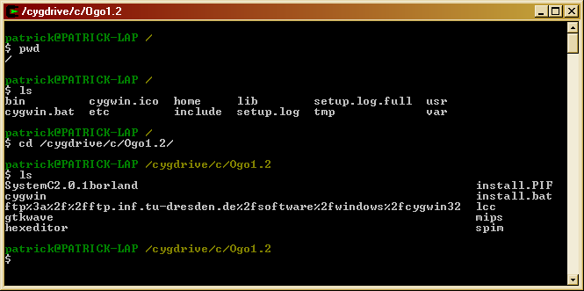
cygwin
Some of the programs we use (LCC, the MIPS assembler) are written as UNIX tools.
The distribution contains a GNU Unix environment called cygwin.
This is a command-line shell.
cd /cygdrive/<drivename> to get to the windows disks.

Slide 9
Getting around in cygwin
Type UNIX
commands here
$ whoami
henk
$ pwd
/
$ ls
bin cygwin.ico home lib setup.log.full usr
cygwin.bat etc include setup.log tmp var
$ cd /cygdrive/c/Ogo1.2/lcc/lccdir
$ ls -l mips-as.exe
-rwxr-xr-x 1 henk unknown 2472629 Nov 22 14:35 mips-as.exe
$ PATH=/cygdrive/c/Ogo1.2/lcc/lccdir:$PATH
$ cd ../..
$ mkdir test
$ cd test
$ mips-as.exe test.asm
henk@HENK-LAP /cygdrive/c/Ogo1.2/test
$ ls
a.out test.asm
$ disas a.out
Which directory am I?
/ = the root
list the directory
go to the windows disk
assembler program
set the search path
make a new subdirectory
run the assembler
run the disassembler

Slide 10

Circuit description in SystemC
A number of hardware description languages exist:
  Verilog (USA)
  VHDL (Japan, Europe)
  SystemC (newer)
  …
They allow you to:
  Describe the logic and functionality
  Describe timing
  Describe parallelism (HW = parallel)
  Check the consistency
  Simulate
  Synthesize hardware (well, not always)

Slide 11
SystemC
SystemC is a C++ library with class definitions.
You write some C++ code using the classes. This describes two issues:
  1 Circuit structure (schematic/functionality)
  2 Simulation settings
Compiling and running it will perform the simulation.
SystemC is just C++ code, though it looks funny.

Slide 12
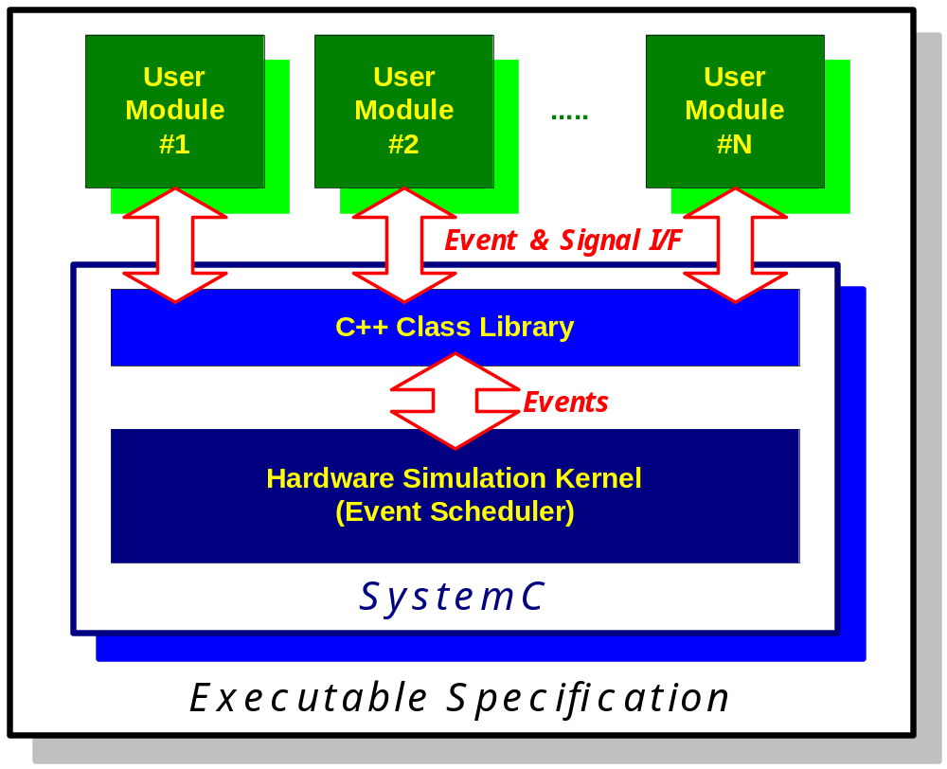
SystemC and User Modules

Slide 13
SystemC usesTemplates; let's have a look
Often we need to use functions that are similar, but that have different data types.
short maximum (short a, short b) {
if(a > b)
return a;
else
return b;
}
int maximum (int a, int b) {
if(a > b)
return a;
else
return b;
}
double maximum (double a, double b) {
if(a > b)
return a;
else
return b;
}
void main(void) {
double p = 10.0, q = 12.0;
int r = 15, s = 1;
double a = maximum(p, q);
int b = maximum(r, s);
}
Can we avoid this duplication
by making the
type a parameter?

Slide 14
Template functions in C++
Lets build a template, and call that type T
Declares T as a ‘variable’ type
template <class T>
T maximum (T a, T b) {
if(a > b)
return a;
else
return b;
}
void main(void) {
double p = 10.0, q = 12.0;
int r = 15, s = 1;
double a = maximum(p, q);
int b = maximum(r, s);
}
returns type T
a and b are of type T
Uses the integer type
Behind the scenes, the compiler builds the routine for each class that is required.
This is a little heavy on the compiler, and also harder to debug.

Slide 15
Template classes in C++
The same can be done with classes!
template <class T>
class coordinate {
public:
coordinate(T x, T y) { _x = x; _y = y; }
~coordinate();
void print(void) {
cout << x << “ , “ << y << endl;
}
private:
T _x, _y;
}
void main(void) {
coordinate <int> a(1, 2);
coordinate <double> b(3.2, 6.4);
a.print();
b.print();
}
1 , 2
3.2 , 6.4
b is the double incarnation
of coordinate.
The class datamembers
_x and _y of parameterized type T
Again, the compiler builds a separate code instance for each type that is required.

Slide 16
SystemC class templates
The word width W is the parameter
Lets look at an example:
template <int W>
class sc_bv
: public sc_bv_base
{
public:
sc_bv();
lrotate( int n );
set_bit(int i, bool value);
…
}
void main(void) {
sc_signal< sc_bv<32> > bus_mux1;
}
Signal wires
32 bit vector
The SystemC class structure is rather complicated.
I suggest to single-step through the example to get a feel for it.

Slide 17
A 2-input or-gate class in SystemC
Instantiates the
input pins a and b.
They carry boolean
sygnals.
This object inherits all
systemC properties
of a pin. how this is
actually implemented
is hidden from us!
This include file contains
all systemc functions and
base classes.
a
OR
o
b
All systemC classes
start with sc_
#include <systemc.h>
SC_MODULE(OR2)
{
sc_in<bool> a; // input pin a
sc_in<bool> b; // input pin b
sc_out<bool> o; // output pin o
SC_CTOR(OR2) // the ctor
{
SC_METHOD(or_process);
sensitive << a << b;
}
void or_process() {
o.write( a.read() || b.read() );
}
};
This sets up a class
containing a module
with a functionality.
Similarly, a boolean
output pin called o
This stuff is executed
during construction
of an ‘or2’ object
Tells the simulator
which function to
run to evaluate the
output pin
This is run to process
the input pins.
Run the method when
signal a or b changes
Calls read and write
member functions
of pins.
This is the actual or!

Slide 18
SystemC program structure
First a data structure is built that describes the circuit.
This is a set of module (cell-)objects with attached pin objects.
Signal objects tie the pins together.
Then the simulation can be started.
The simulation needs:
  input values
  the list of pins that is to reported.
#include <systemc.h>
#include “and.h”
#include “or.h”
// etc..
int sc_main(int argc, char *argv[])
{
// 1: Instantiate gate objects
…
// 2: Instantiate signal objects
…
// 3: Connect the gates to signals
…
// 4: specify which values to print
// 5: put values on signal objects
// 6: Start simulator run
}

Slide 19
Step 1: make the gate objects
OR1
AND3
NOR7
INV9
AND4
AND5
OR2
OR8
AND6
Instance name
Module type
// 1: instantiate the gate objects
OR2 or1("or1"), or8(“or8”);
OR3 or2(“or2”);
AND2 and3("and3"), and4("and4"), and5("and5");
AND3 and6("and6");
NOR2 nor7(“nor7");
INV inv9(“inv9”);
// … continued next page
Name stored
in instance

Slide 20
Step 2: make the signal objects
or_1
and_3
OR1
nor_7
AND3
CO
NOR7
INV9
AND4
and_4
and_5
or_2
AND5
OR2
OR8
SUM
A
B
CI
Template class
used for boolean
AND6
and_6
Boolean
signal
// … continued from previous page
// 2: instantiate the signal objects
sc_signal<bool> A, B, CI; // input nets
sc_signal<bool> CO, SUM; // output nets
sc_signal<bool> or_1, or_2, and_3, and_4; // internal nets
sc_signal<bool> and_5, and_6, nor_7; // internal nets
// … continued next page

Slide 21
Step 3: Connecting pins of gates to signals
or_1
and_3
OR1
AND3
CO
NOR7
INV9
nor_7
AND4
and_4
and_5
or_2
AND5
OR2
OR8
SUM
A
B
CI
AND6
and_6
Gate instance object or2
pin object o
// 3: Connect the gates to the signal nets
or1.a(A); or1.b(B); or1.o(or_1);
or2.a(A); or2.b(B); or2.c(CI); or2.o(or_2);
and3.a(or_1); and3.b(CI); and3.o(and_3);
and4.a(A); and4.b(B); and4.o(and_4);
and5.a(nor_7); and5.b(or_2); and5.o(and_5);
and6.a(A); and6.b(B); and6.c(CI); and6.o(and_6);
nor7.a(and_3); nor7.b(and_4); nor7.o(nor_7);
or8.a(and_5); or8.b(and_6); or8.o(SUM);
inv9.a(nor_7); inv9.o(CO);
// … continued next page
Signal net object

Slide 22
Running the simulation
// .. continued from previous page
sc_initialize(); // initialize the simulation engine
// create the file to store simulation results
sc_trace_file *tf = sc_create_vcd_trace_file("trace");
// 4: specify the signals we’d like to record in the trace file
sc_trace(tf, A, "A"); sc_trace(tf, B, "B");
sc_trace(tf, CI, “CI");
sc_trace(tf, SUM, “SUM"); sc_trace(tf, CO, "CO");
// 5: put values on the input signals
A=0; B=0; CI=0; // initialize the input values
sc_cycle(10);
for( int i = 0 ; i < 8 ; i++ ) // generate all input combinations
{
A = ((i & 0x1) != 0); // value of A is the bit0 of i
B = ((i & 0x2) != 0); // value of B is the bit1 of i
CI = ((i & 0x4) != 0); // value of CI is the bit2 of i
sc_cycle(10); // evaluate
}
sc_close_vcd_trace_file(tf); // close file and we’re done
}

Slide 23
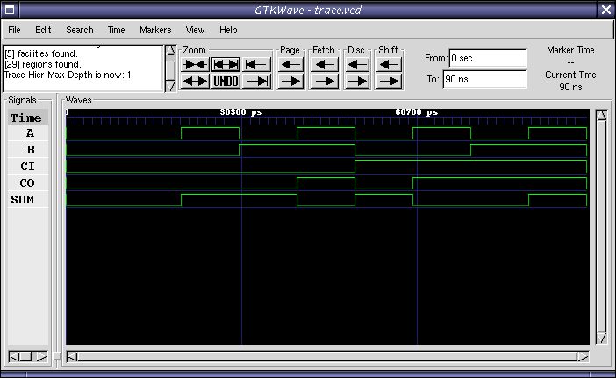
Waveform viewer

Slide 24
Modules
Modules are the basic building blocks to partition a design
  they allow to partition complex systems in smaller components
Modules hide internal data representation, use interfaces
Modules are classes in C++
A module is similar to an „entity“ in VHDL
  SC_MODULE(module_name)
  {
    // Ports declaration
    // Signals declaration
    // Module constructor : SC_CTOR
    // Process constructors and sensibility list
    // SC_METHOD
    // Sub-Modules creation and port mappings
    // Signals initialization
  }

Slide 25
A Mux 2:1 module
SC_MODULE( Mux21 ) {
sc_in< sc_uint<8> > in1;
sc_in< sc_uint<8> > in2;
sc_in< bool > selection;
sc_out< sc_uint<8> > out;
void doIt( void );
SC_CTOR( Mux21 ) {
SC_METHOD( doIt );
sensitive << selection;
sensitive << in1;
sensitive << in2;
}
};
MUX
in1
out
in2
selection

Slide 26
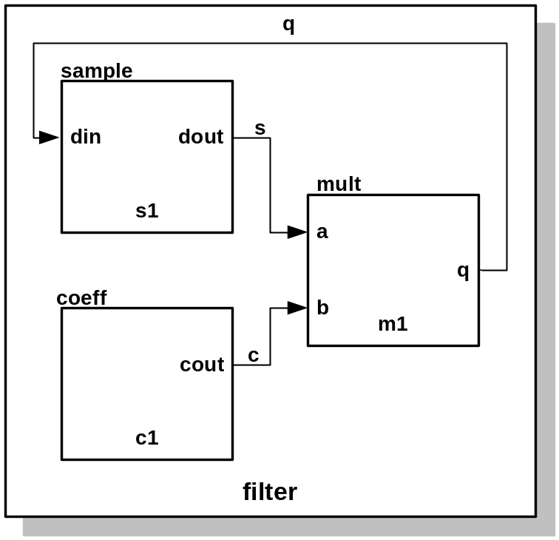
Submodules and Connections
SC_MODULE(filter)
{
// Sub-modules : “components
sample *s1;
coeff *c1;
mult *m1;
sc_signal<sc_uint <32> > q, s, c; // Signals
// Constructor : “architecture”
SC_CTOR(filter)
{
// Sub-modules instantiation and mapping
s1 = new sample (“s1”);
s1->din(q); // named mapping
s1->dout(s);
c1 = new coeff(“c1”);
c1->out(c); // named mapping
m1 = new mult (“m1”);
(*m1)(s, c, q); // Positional mapping
}
}
Example: 'filter'

Slide 27
3 types of Processes
Methods
  When activated, executes and returns (just like a function)
  SC_METHOD(process_name);
  no staticly kept state
  activated by event on sensitivity list
Threads
  Can be suspended and reactivated
  wait() -> suspends execution
  activated by event on sensitivity list
  SC_THREAD(process_name);
CThreads
  Activated by the clock pulse
  SC_CTHREAD(process_name, clock value);

Slide 28
Defining the Sensitivity List of a Process
sensitive with the ( ) operator
  Takes a single port or signal as argument
  sensitive(sig1); sensitive(sig2); sensitive(sig3);
sensitive with the stream notation
  Takes an arbitrary number of arguments
  sensitive << sig1 << sig2 << sig3;
sensitive_pos with either ( ) or << operator
  Defines sensitivity to positive edge of Boolean signal or clock
  sensitive_pos << clk;
sensitive_neg with either ( ) or << operator
  Defines sensitivity to negative edge of Boolean signal or clock
  sensitive_neg << clk;

Slide 29
An Example of an SC_THREAD
void do_count() {
while(1) {
if(reset) {
value = 0;
}
else if (count) {
value++;
q.write(value);
}
wait();
}
}
Repeat forever
Wait till next event !

Slide 30
Thread Processes: wait( ) Function
wait( ) may be used in both SC_THREAD and SC_CTHREAD processes but not in SC_METHOD process block
wait( ) suspends execution of the process until the process is invoked again
wait(<pos_int>) may be used to wait for a certain number of cycles (SC_CTHREAD only)
In Synchronous process (SC_CTHREAD)
  Statements before the wait( ) are executed in one cycle
  Statements after the wait( ) executed in the next cycle
In Asynchronous process (SC_THREAD)
  Statements before the wait( ) are executed in the last event
  Statements after the wait( ) are executed in the next even

Slide 31
SC_THREAD Example
SC_MODULE(my_module)
{
sc_in<bool> id;
sc_in<bool> clock;
sc_in<sc_uint<3> > in_a;
sc_in<sc_uint<3> > in_b;
sc_out<sc_uint<3> > out_c;
void my_thread();
SC_CTOR(my_module)
{
SC_THREAD(my_thread);
sensitive << clock.pos();
}
};
Thread implementation:
//my_module.cpp
void my_module:: my_thread()
{
while(true)
{
if (id.read())
out_c.write(in_a.read());
else
out_c.write(in_b.read());
wait();
}
};

Slide 32
SC_CTHREAD
Will be deprecated in future releases
  Almost identical to SC_THREAD, but implements “clocked threads”
  Sensitive only to one edge of one and only one clock
  It is not triggered if inputs other than the clock change
Models the behavior of unregistered inputs and registered outputs
Useful for high level simulations, where the clock is used as the only synchronization device
Adds wait_until( ) and watching( ) semantics for easy deployment

Slide 33
Counter in SystemC
SC_MODULE(countsub)
{
sc_in<double> in1;
sc_in<double> in2;
sc_out<double> sum;
sc_out<double> diff;
sc_in<bool> clk;
void addsub();
// Constructor:
SC_CTOR(countsub)
{
// Declare addsub as SC_METHOD
SC_METHOD(addsub);
// make it sensitive to
// positive clock
sensitive_pos << clk;
}
};
//Definition of addsub method
void countsub::addsub()
{
double a;
double b;
a = in1.read();
b = in2.read();
sum.write(a+b);
diff.write(a-b);
};
in1
adder
subtractor
sum
in2
diff
clk

Slide 34
Ports and Signals
Ports of a module are the external interfaces that pass information to and from a module
In SystemC one port can be IN, OUT or INOUT
Signals are used to connect module ports allowing modules to communicate
Similar to ports and signals in VHDL

Slide 35
Ports and Signals
Types of ports and signals:
  All natives C/C++ types
  All SystemC types
  User defined types
How to declare
  IN : sc_in<port_typ>
  OUT : sc_out<port_type>
  Bi-Directional : sc_inout<port_type>

Slide 36
Ports and Signals
How to read and write a port ?
  Methods read( ); and write( );
Examples:
  in_tmp = in.read( ); //reads the port in to in_tmp
  out.write(out_temp); //writes out_temp in the out port

Slide 37
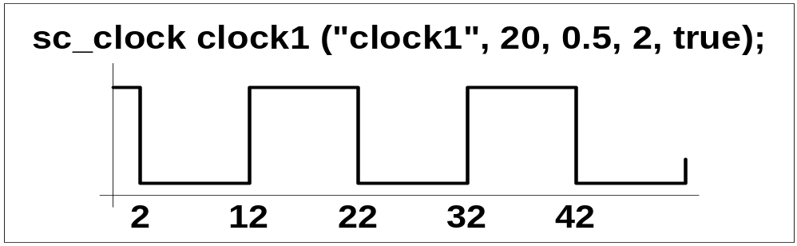
Clocks
Special object
How to create ?
  sc_clock clock_name (
  “clock_label”, period, duty_ratio, offset, initial_value );
Clock connection
    f1.clk( clk_signal ); //where f1 is a module

Slide 38
Data Types
SystemC supports:
  all C/C++ native types
  plus specific SystemC types
SystemC types
  Types for systems modelling
  2 values (‘0’,’1’)
  4 values (‘0’,’1’,’Z’,’X’)
  Arbitrary size integer (Signed/Unsigned)
  Fixed point types

Slide 39
SC_LOGIC type
More general than bool, 4 values :
  (‘0’ (false), ‘1’ (true), ‘X’ (undefined) , ‘Z’(high-impedance) )
Assignment like bool
  my_logic = ‘0’;
  my_logic = ‘Z’;
Simulation time bigger than bool
Operators like bool
Declaration
  sc_logic my_logic;

Slide 40
Fixed precision integers
Used when arithmetic operations need fixed size arithmetic operands
INT can be converted in UINT and vice-versa
“int” in C++
  The size depends on the machine
  Faster in the simulation
1-64 bits integer in SystemC
  sc_int<n> -- signed integer with n-bits
  sc_uint<n> -- unsigned integer with n-bits

Slide 41
Arbitrary precision integers
Integer bigger than 64 bits
  sc_bigint<n>
  sc_biguint<n>
More precision, slow simulation
Can be used together with:
  Integer C++
  sc_int, sc_uint

Slide 42
Other SystemC types
Bit vector
  sc_bv<n>
  2-valued vector (0/1)
  Not used in arithmetics operations
  Faster simulation than sc_lv
Logic Vector
  sc_lv<n>
  Vector of the 4-valued sc_logic type
Assignment operator (“=“)
  my_vector = “XZ01”
  Conversion between vector and integer (int or uint)
  Assignment between sc_bv and sc_lv

Slide 43
SystemC types overview
Type | Description
sc_logic | Simple bit with 4 values(0/1/X/Z)
sc_int | Signed Integer from 1-64 bits
sc_uint | Unsigned Integer from 1-64 bits
sc_bigint | Arbitrary size signed integer
sc_biguint | Arbitrary size unsigned integer
sc_bv | Arbitrary size 2-values vector
sc_lv | Arbitrary size 4-values vector
sc_fixed | templated signed fixed point
sc_ufixed | templated unsigned fixed point
sc_fix | untemplated signed fixed point
sc_ufix | untemplated unsigned fixed point
See chapter 7 of the SystemC user manual for all details on Fixed Point Types

Slide 44
Examples of use of SystemC types
sc_bit y, sc_bv<8> x;
y = x[6];
sc_bv<16> x, sc_bv<8> y;
y = x.range(0,7);
sc_bv<64> databus, sc_logic result;
result = databus.or_reduce();
sc_lv<32> bus2;
cout << “bus = “ << bus2.to_string();

Slide 45
Example – Half adder
#include “systemc.h”
SC_MODULE(half_adder) {
sc_in<bool> a, b;
sc_out<bool>sum, carry;
void proc_half_adder();
SC_CTOR(half_adder) {
SC_METHOD (proc_half_adder);
sensitive << a << b;
}
};
void half_adder::proc_half_adder() {
sum = a ^ b;
carry = a & b;
}
half-adder
a
sum
b
carry

Slide 46
Describing Hierarchy: Full adder
#include “half_adder.h”
SC_MODULE (full_adder) {
sc_in<bool>a, b, carry_in;
sc_out<bool>sum, carry_out;
sc_signal<bool>c1, s2, c2;
void proc_or();
half_adder ha1(“ha1”), ha2(“ha2”);
SC_CTOR(full_adder) {
ha1.a(a); //by name connection
ha1.b(b);
ha1.sum(s1);
ha1.carry(c1);
h2(s1, carry_in, sum, c2) //by position connection
SC_METHOD (proc_or);
sensitive << c1 << c2;
}
};
a
half-adder ha1
sum
a
sum
b
half-adder ha2
b
carry
a
sum
carry_in
b
carry

Slide 47
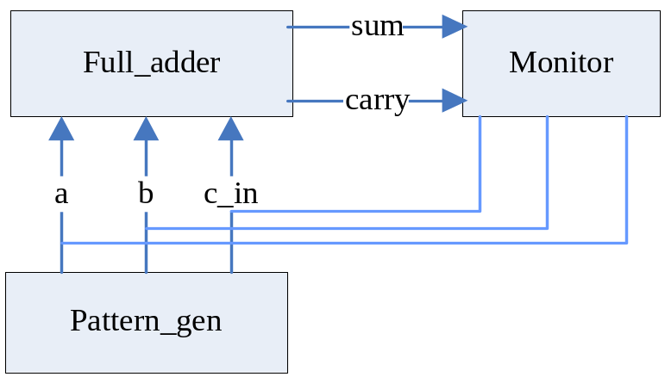
Main --- Top Module
#Include “full_adder.h”
#Include “pattern_gen.h”
#include “monitor.h”
int sc_main(int argc, char* argv[]) {
sc_signal<booL> t_a, t_b, t_cin, t_sum, t_cout;
full_adder f1(“Fulladder”);
//connect using positional association
f1 << t_a << t_b << t_cin << t_sum << t_cout;
pattern_gen pg_ptr = new
pattern_gen(“Generation”);
//connection using named association
pg_ptr->d_a(t_a);
pg_ptr->d_b(t_b);
(*pg_ptr->d_cin(t_cin);
monitor mol(“Monitor”);
mo1 << t_a << t_b << t_cin << t_sum << t_cout;
sc_start(100, SC_NS);
return 0;
}

Slide 48
SystemC Highlights Summary (1)
Support Hardware-Software Co-Design
Interface in a C++ environment
  Modules
    Container class includes hierarchical Entity and Processes
  Processes
    Describe functionality, Event sensitivity
  Ports
    Single-directional(in, out), Bi-directional(inout) mode
  Signals
    Resolved, Unresolved signals
  Rich set of port and signal types
  Rich set of data types
    All C/C++ types, 32/64-bit signed/unsigned, fixed-points, MVL, user defined

Slide 49
SystemC Highlights Summary (2)
Interface in a C++ environment (continued)
  Clocks
    Special signal, Timekeeper of simulation and Multiple clocks, with arbitrary phase relationship
  Cycle-based simulation
    High-Speed Cycle-Based simulation kernel
  Multiple abstraction levels
    Untimed from high-level functional model to detailed clock cycle accuracy RTL model
  Communication Protocols
  Debugging Supports
    Run-Time error check
  Waveform Tracing

